Slide 1
YARN fault tolerance and scalability

Slide 2
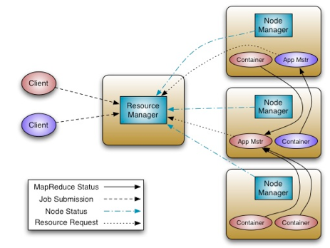
Fault Tolerance
Task (Container) Failure – Handled just like in MapReduce 1
MRAppMaster will re-attempt tasks that complete with exception or stop responding (4 times by default)
Applications with too many failed tasks are considered failed
Application master will handle failure of container

Slide 3
Fault Tolerance
Application Master Failure
If application fails or if Application Master stops sending heartbeats, Resource Manager will re-attempt the whole application (2 times by default)
MRAppMaster optional setting: Job recovery
If false, all tasks will re-run
If true, MRAppMaster retrieves state of tasks when it restarts; only incomplete tasks will be re-run.
Resource Manager will handle failure of application master

Slide 4
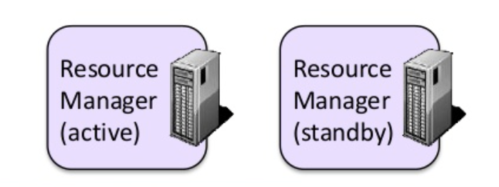
Any of the following can Fail
Node Manager
If Node Manager stops sending heartbeats to Resource Manager, it is removed from list of active nodes
Tasks on the node will be treated as failed by MRAppMaster
If the MRAppMaster node fails, it will be treated as a failed application
Resource Manager
No applications or tasks can be launched if Resource Manager is unavailable
Can be configured with High Availability

Slide 5
Scalability
The scalability of Yarn comes from the fact each ApplicationMaster manages a single job or single DAG of jobs.
The single resource manager is only responsible for resource allocation.

Slide 6
Key Point about Yarn
MapReduce 2 is based on Yarn
Yarn replaces JobTracker/TaskTracker architecture of MR 1
ResourceManager handles resource allocation and scheduling for the cluster
Multiple ApplicationMasters handle application-specific job processing
Why?
More scalable
More efficient
More flexible

